Slide 1
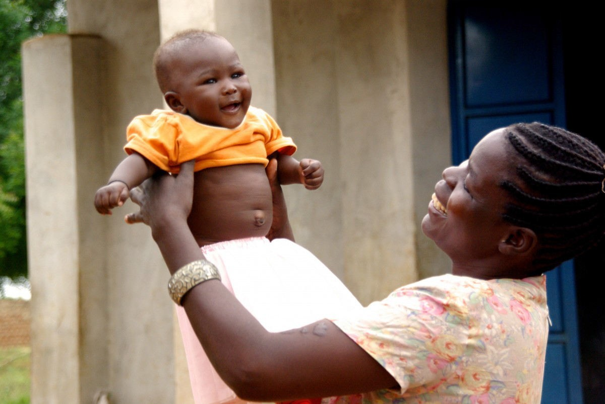

GNUHealth
Fre SoftwaretechnologyimprovingPublicHealthcarearoundtheworld
Celebrating 10 years of Freedom and Equity in Healthcare
LuisFalcón,M.D.,B.Sc President,GNUSolidario falcon@gnu.org
openSUSEConference,osCON18 CzechRepublic,May26th,2018
LuisFalcónMartín GnuSolidario.CC-BY-NC-SA4.0

Slide 2

GNUHealth:Fredom andEquityinHealth
GNU Health is a Social Project
...that uses really cool technology
openSUSEConference,osCON18 CzechRepublic,May26th,2018
LuisFalcónMartín GnuSolidario.CC-BY-NC-SA4.0

Slide 3
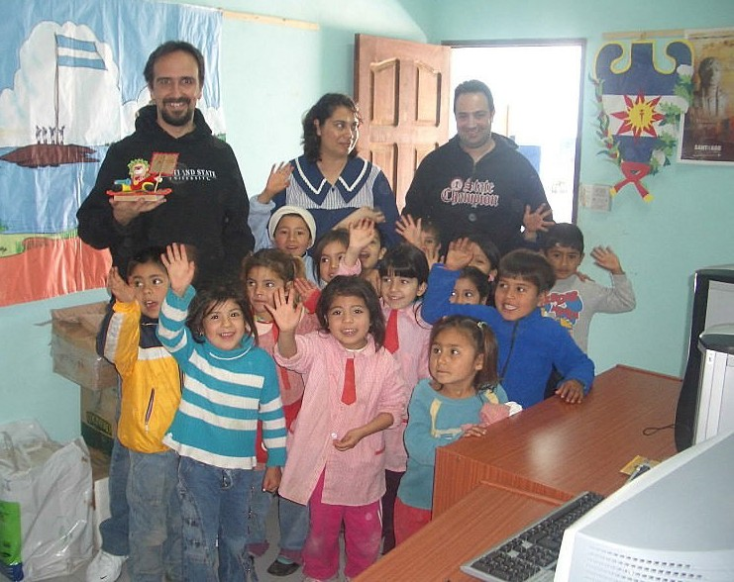

AboutGNUSolidario
“DeliveringHealthandEducationwithFre Software”
GNUHealth
TheFre HealthandHospital InformationSystem.(health.gnu.org)
GNUHealthCon-IWEEE InternationalWorkshoponE-Health inEmergingEconomies.
GNUSolidariofirstproject:SantiagodelEstero,Argentina,2006
openSUSEConference,osCON18 CzechRepublic,May26th,2018
LuisFalcónMartín GnuSolidario.CC-BY-NC-SA4.0

Slide 4

LesMiserables
openSUSEConference,osCON18 CzechRepublic,May26th,2018
LuisFalcónMartín GnuSolidario.CC-BY-NC-SA4.0

Slide 5

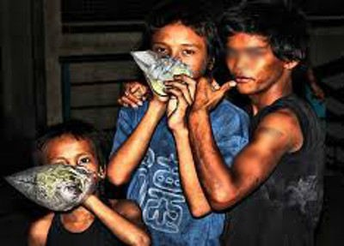
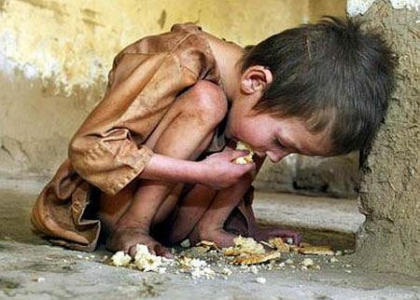

Over20000Childrendieeverydayfrom SocialDiseases–inmisery
HumanTrafficking ContaminatedWater Malnutrition Cholera Drugabuse Prostitution Chagas Tuberculosis ChildLabour
War FamilyViolence
Malaria HIV/AIDS
openSUSEConference,osCON18 CzechRepublic,May26th,2018
LuisFalcónMartín GnuSolidario.CC-BY-NC-SA4.0

Slide 6
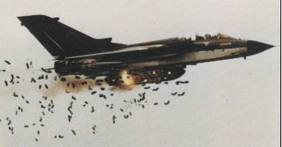
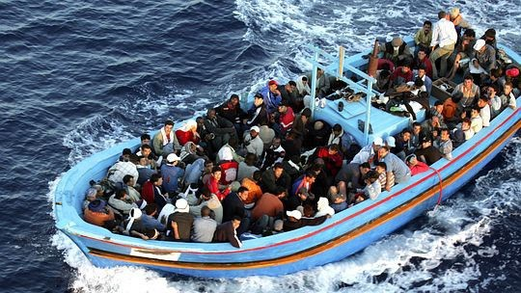


TheotherMiserables:Thosewhocausemisery
The macabre business of war
openSUSEConference,osCON18 CzechRepublic,May26th,2018
LuisFalcónMartín GnuSolidario.CC-BY-NC-SA4.0

Slide 7
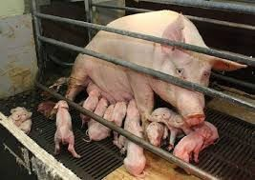
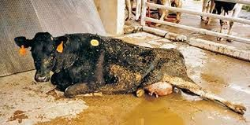
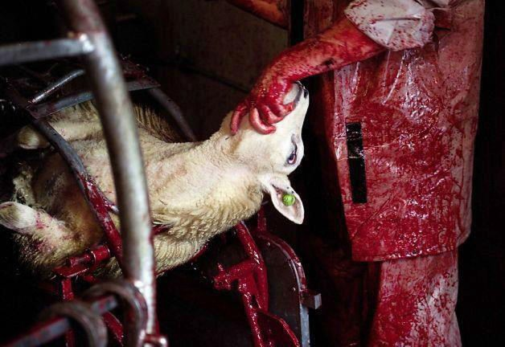
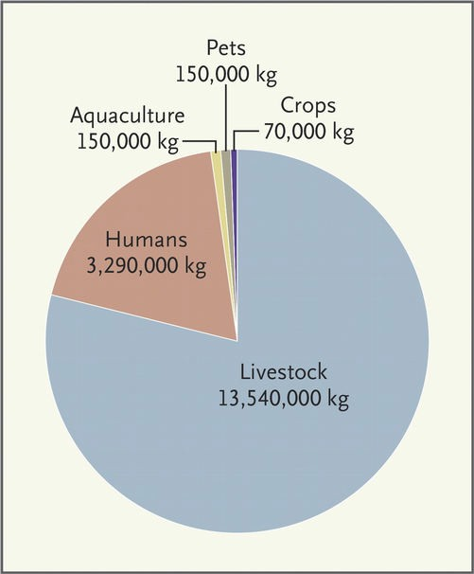
DairyandMeat:Inhumane,CruelandUnhealthy
Extremely cruel
Stress → immunocompromise → ATB → Resistance
Bacteria contamination
Milk / meat full with ATB, Hormones, …
Linked to cancer, cardiovascular disease in humans
Global warming
New England Journal of Medicine
Dec 26, 2013
Factory farming accounts for 37% of methane emissions, 20 times the global warming potential of CO .
2
openSUSEConference,osCON18 CzechRepublic,May26th,2018
LuisFalcónMartín GnuSolidario.CC-BY-NC-SA4.0

Slide 8
GNUHealth:NatureandNurture
Current System of Disease (reductionist)
“GNU” System of Health
People before patients
biology
Biology
Govt / Community
Education
Disease
Meds
Biological Psychological Social
Patient
Nutrition
Exercise
expensive
Acute
Reactive
Invasive
Affection
Work
Housing
health.gnu.org
openSUSEConference,osCON18 CzechRepublic,May26th,2018
LuisFalcónMartín GnuSolidario.CC-BY-NC-SA4.0

Slide 9

GNUHealth:Functionality
PersonandCommunity
→Person,families
→DomiciliaryUnits,
→HealthInstitutions,profesionals
→Socioeconomics,lifestyle.
Patient
→Medicalhistory,Evaluations,ap ointments
→Genetics&familyhistory
→Prescriptions
→surgeries…
HealthInstitutionManagement
→Finances,Biling
→StockManagement,pharmacies
→Hospitalizations,Inpatientcomplex
→LIMS
→EmergencyManagement.
HealthAuthorities/MoH
* Civil/VitalRecordSystem
→Healthcampaigns
→Epidemiology
→Federation,distributedhealthnetworks.
openSUSEConference,osCON18 CzechRepublic,May26th,2018
LuisFalcónMartín GnuSolidario.CC-BY-NC-SA4.0

Slide 10











GNUHealthisFre/LibreSoftware
OfficialGNUPackage,from theFre SoftwareFoundation
OpenDocumentation Reliesonfre technology
Internationalcommunity(100+languageteams)
openSUSEConference,osCON18 CzechRepublic,May26th,2018
LuisFalcónMartín GnuSolidario.CC-BY-NC-SA4.0

Slide 11
health.gnu.org
Demographics CommunityandInfrastructure
openSUSEConference,osCON18 CzechRepublic,May26th,2018
LuisFalcónMartín GnuSolidario.CC-BY-NC-SA4.0

Slide 12
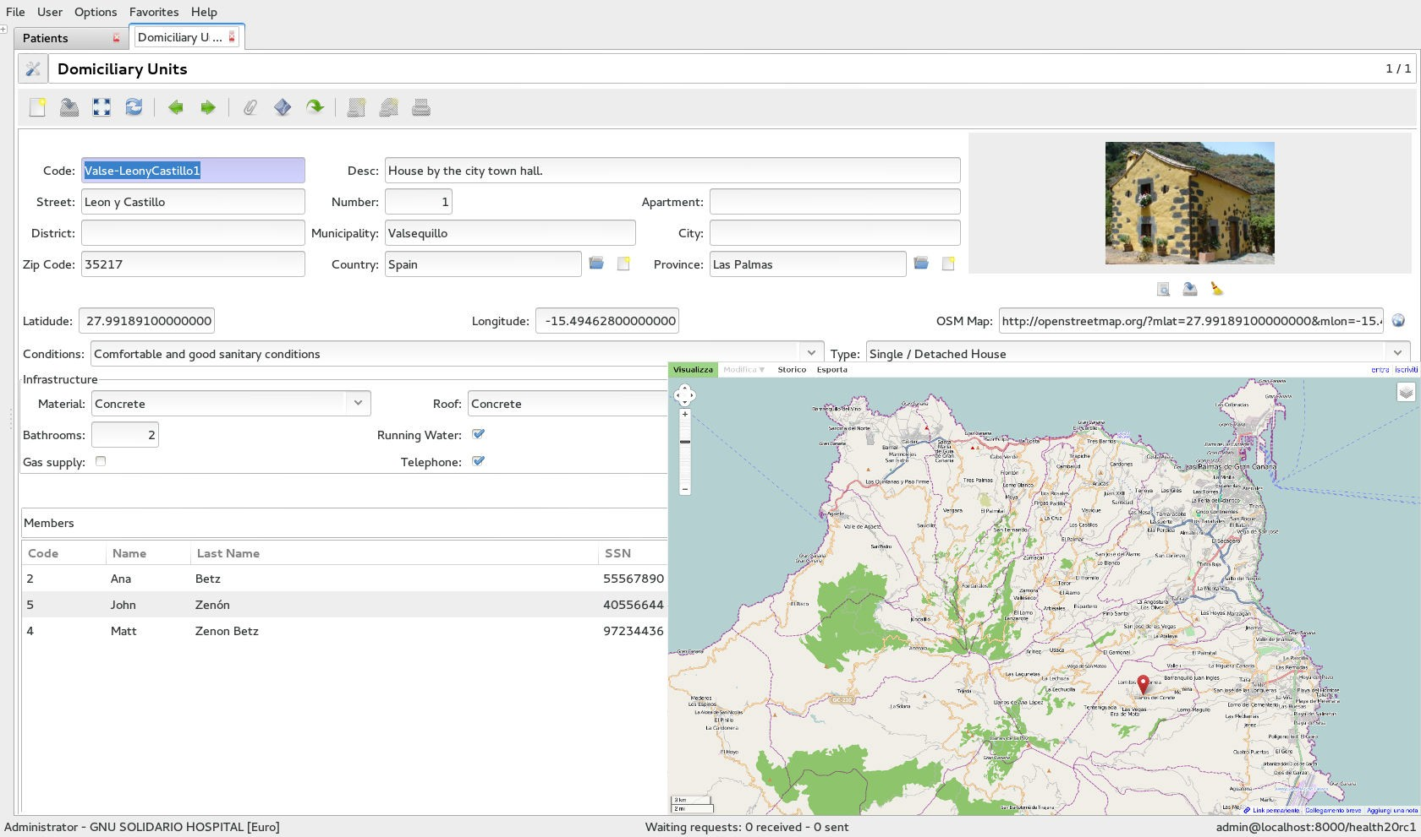
TheDomiciliaryUnits(DUs)
Address / Location Construction material Number of rooms
Sanitary conditions
Bathrooms Sewers Electricity
...
The DU shows the people currently living in it at any given moment The DU can be geolocated / linked to OpenStreetMap
openSUSEConference,osCON18 CzechRepublic,May26th,2018
LuisFalcónMartín GnuSolidario.CC-BY-NC-SA4.0

Slide 13
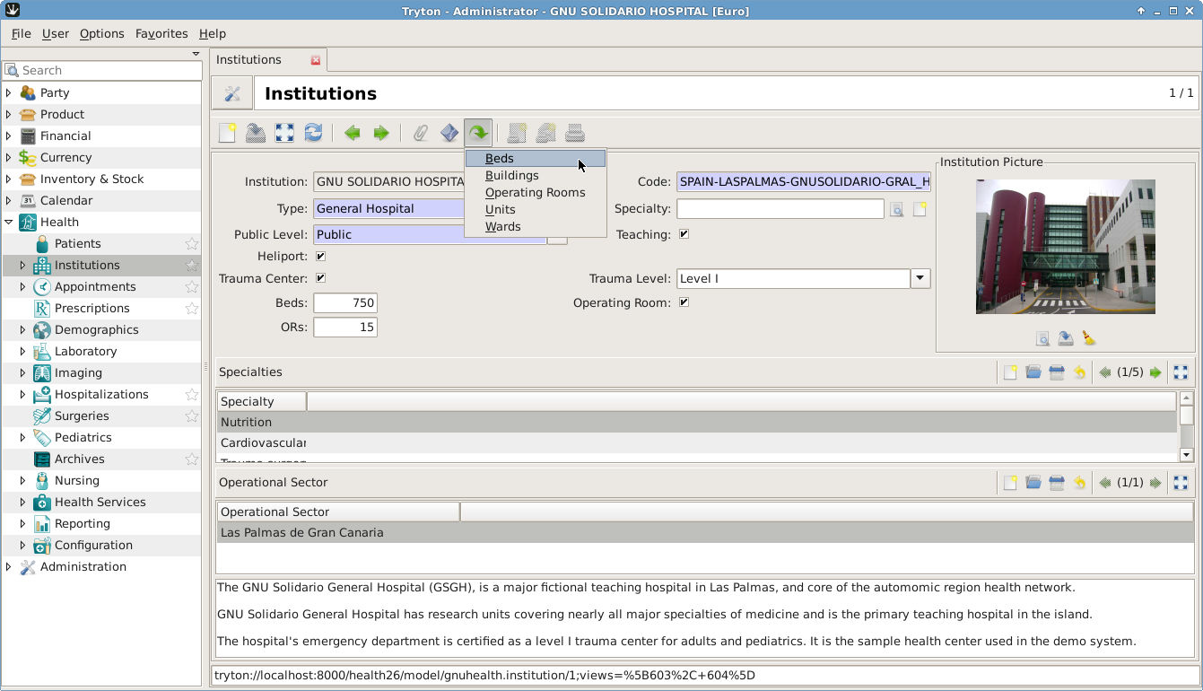
HealthInstitutionsandOperationalSectors
openSUSEConference,osCON18 CzechRepublic,May26th,2018
LuisFalcónMartín GnuSolidario.CC-BY-NC-SA4.0

Slide 14
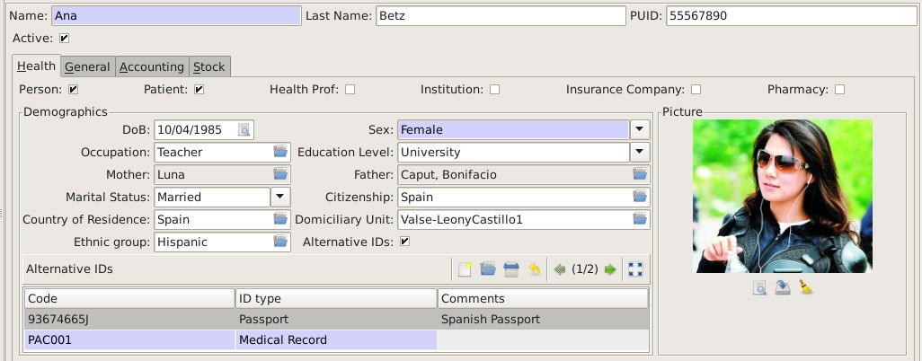
PeopleBeforePatients:Demographics
openSUSEConference,osCON18 CzechRepublic,May26th,2018
LuisFalcónMartín GnuSolidario.CC-BY-NC-SA4.0

Slide 15
health.gnu.org
MedicalPracticeand HealthCenterManagement
openSUSEConference,osCON18 CzechRepublic,May26th,2018
LuisFalcónMartín GnuSolidario.CC-BY-NC-SA4.0

Slide 16
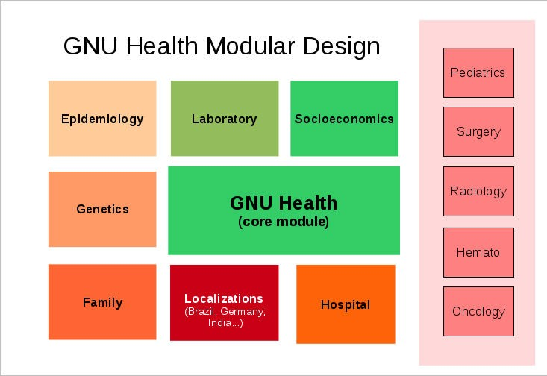
Modularity
openSUSEConference,osCON18 CzechRepublic,May26th,2018
LuisFalcónMartín GnuSolidario.CC-BY-NC-SA4.0

Slide 17
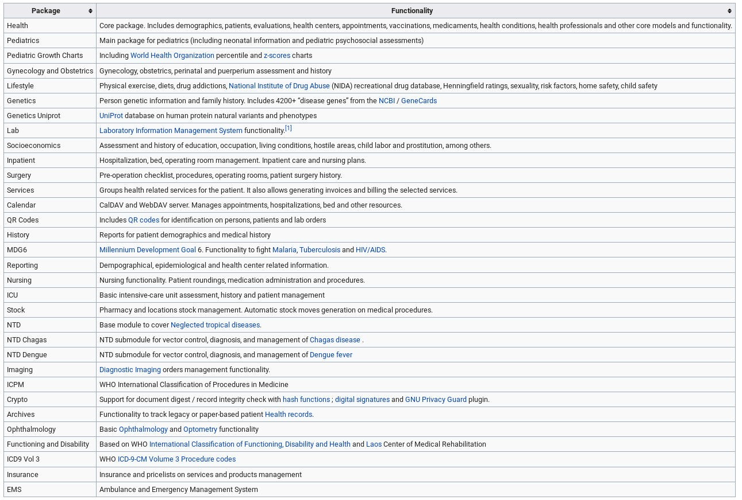
Someofcurentpackages
openSUSEConference,osCON18 CzechRepublic,May26th,2018
LuisFalcónMartín GnuSolidario.CC-BY-NC-SA4.0

Slide 18
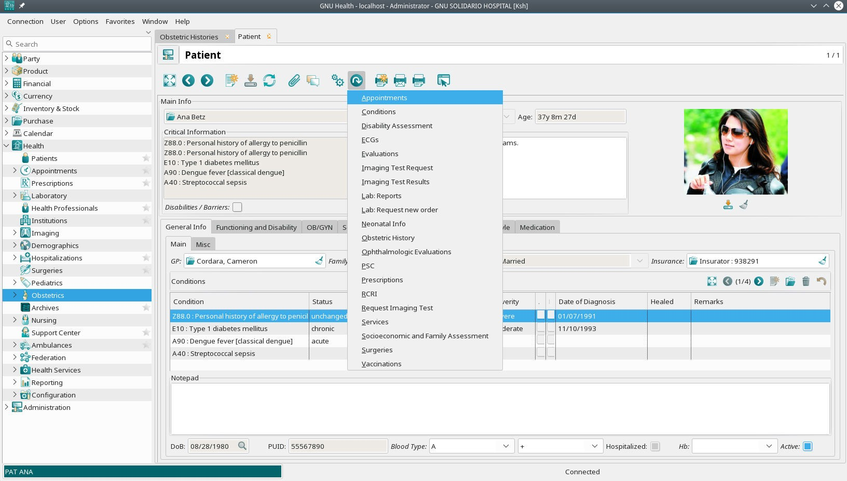
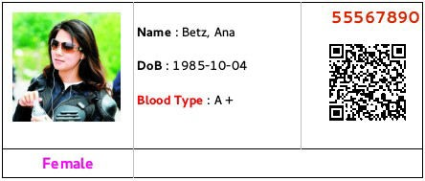
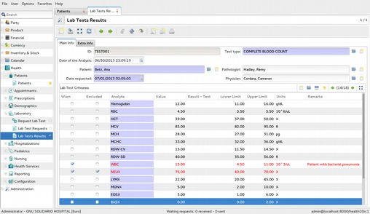
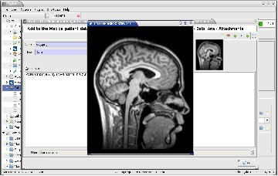
PatientManagement
Critical Info : T1D
openSUSEConference,osCON18 CzechRepublic,May26th,2018
LuisFalcónMartín GnuSolidario.CC-BY-NC-SA4.0

Slide 19
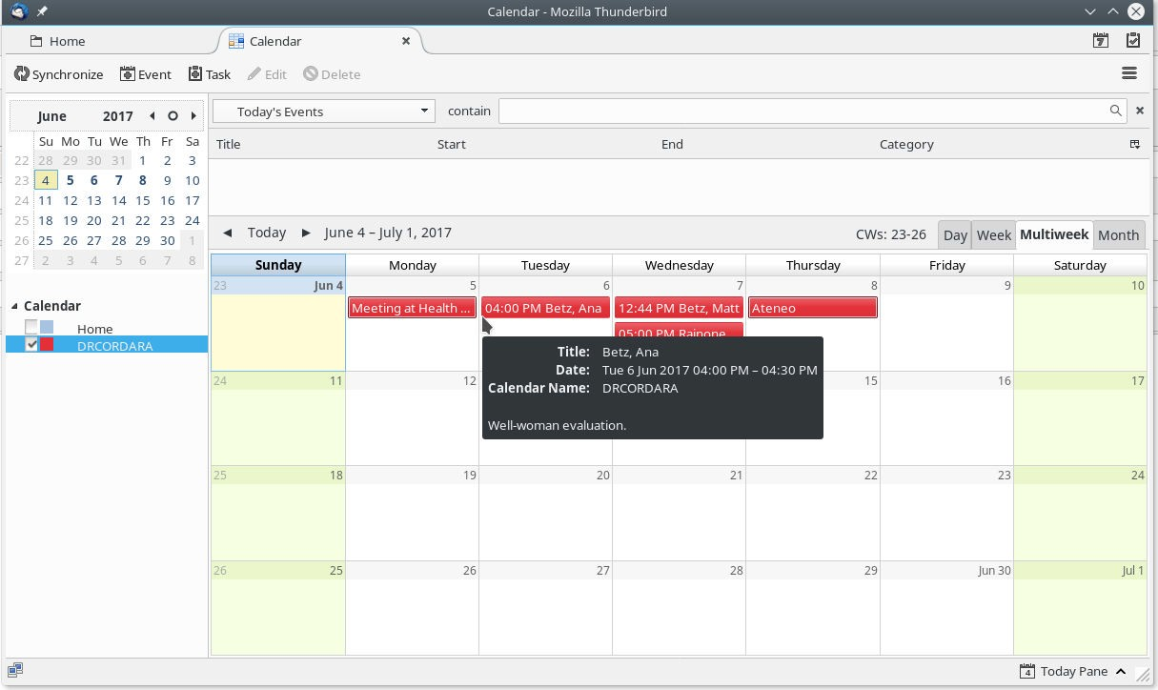
Calendarfunctionality
openSUSEConference,osCON18 CzechRepublic,May26th,2018
LuisFalcónMartín GnuSolidario.CC-BY-NC-SA4.0

Slide 20


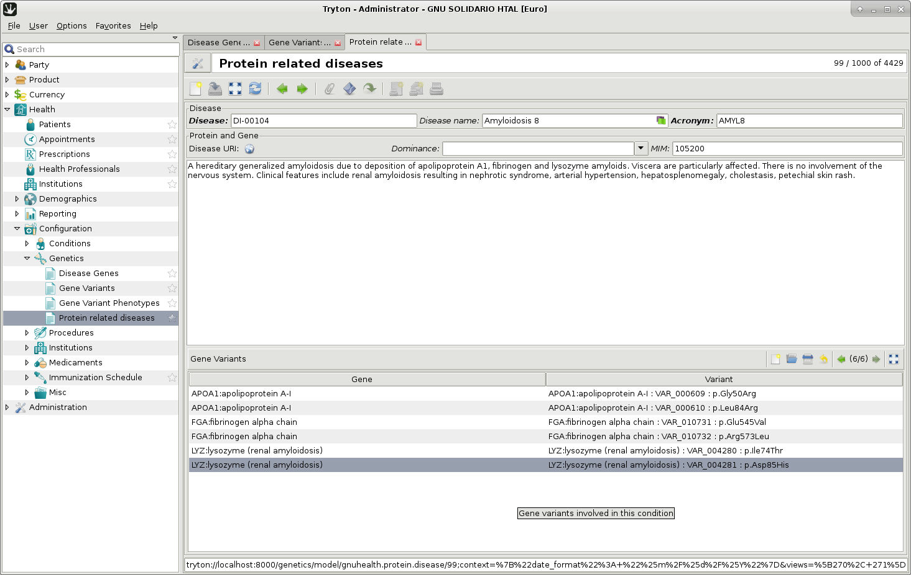
BioinformaticsandPrecisionMedicine
Linking clinicians with research
Personal genetic information & family history Work with Uniprot
Protein related diseases
Gene Natural Variants & phenotypes
GNU Health Federation to interact with scientific community
openSUSEConference,osCON18 CzechRepublic,May26th,2018
LuisFalcónMartín GnuSolidario.CC-BY-NC-SA4.0

Slide 21

GNULIMS
Laboratory Information System for HealthCare and Biomedicine
openSUSEConference,osCON18 CzechRepublic,May26th,2018
LuisFalcónMartín GnuSolidario.CC-BY-NC-SA4.0

Slide 22
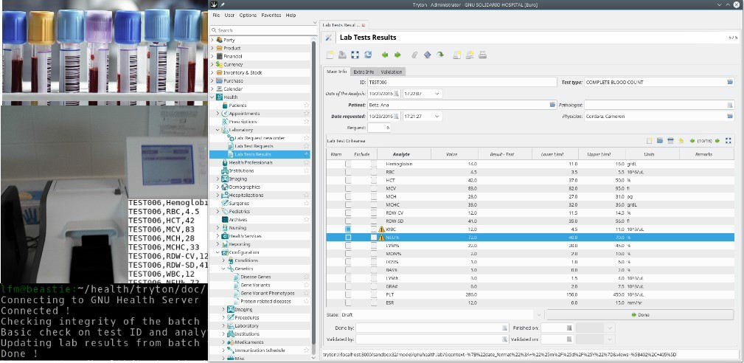

GNULIMS:InteroperabilityandInterfaces
openSUSEConference,osCON18 CzechRepublic,May26th,2018
LuisFalcónMartín GnuSolidario.CC-BY-NC-SA4.0

Slide 23

DxImaging
GNUHealth
PACSserver
Canstoretheimage,metadata orDICOMDIRlocation
openSUSEConference,osCON18 CzechRepublic,May26th,2018
LuisFalcónMartín GnuSolidario.CC-BY-NC-SA4.0

Slide 24
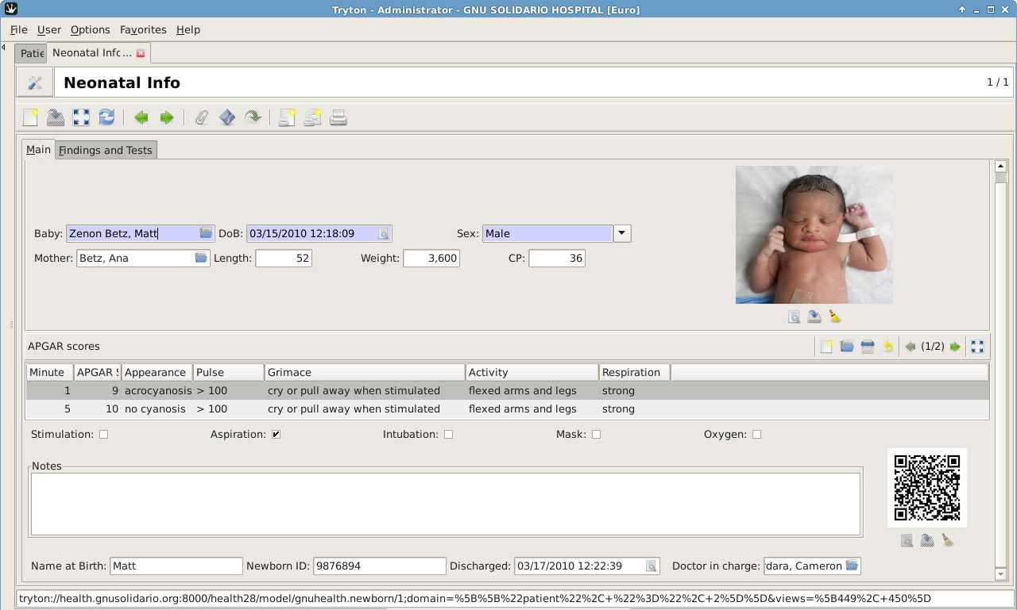
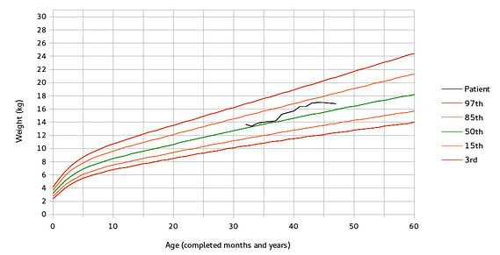
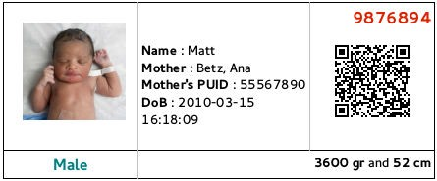
Obstetrics&Pediatrics
PreconceptionandPrenatalCare GeneticRisksandcounseling Obstetricevaluations/imaging Nutritionandgrowthcharts Socioeconomics
Neonatology Immunizations
FamilyFunctionalityandAffectionlevel PsychosocialRisk(Mas GeneralHospitalPSC)
openSUSEConference,osCON18 CzechRepublic,May26th,2018
LuisFalcónMartín GnuSolidario.CC-BY-NC-SA4.0

Slide 25
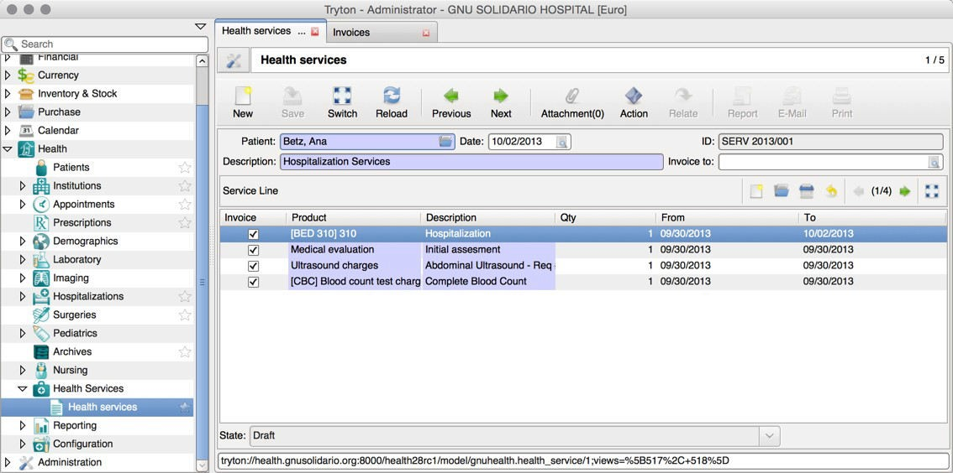
HealthServices,Biling/Invoicing
openSUSEConference,osCON18 CzechRepublic,May26th,2018
LuisFalcónMartín GnuSolidario.CC-BY-NC-SA4.0

Slide 26

Interoperability
openSUSEConference,osCON18 CzechRepublic,May26th,2018
LuisFalcónMartín GnuSolidario.CC-BY-NC-SA4.0

Slide 27
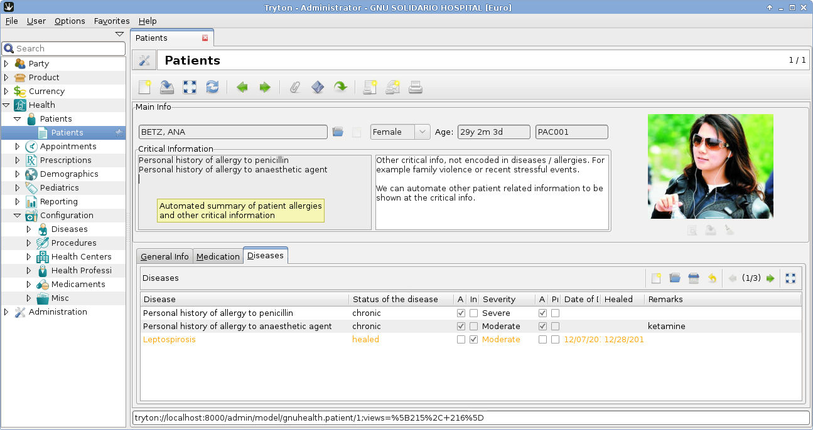
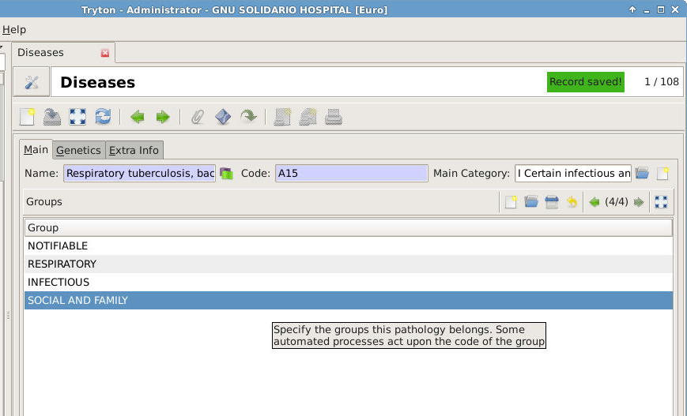
DiseaseGroups
Tuberculosis example
Automatic triggers
Patient Critical Info Reporting
openSUSEConference,osCON18 CzechRepublic,May26th,2018
LuisFalcónMartín GnuSolidario.CC-BY-NC-SA4.0

Slide 28
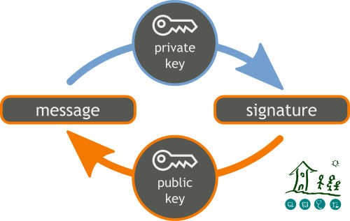
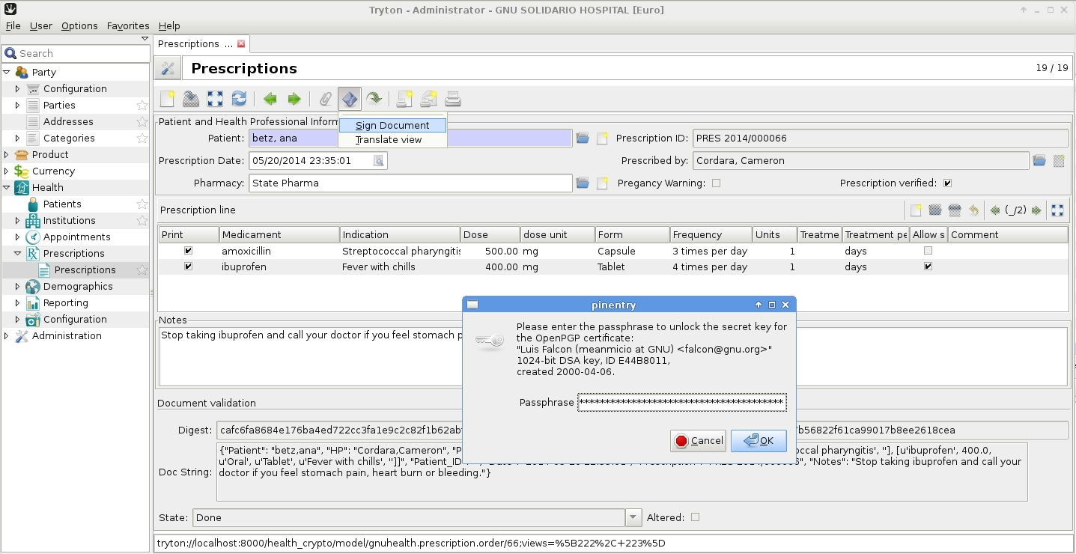
DigitalSignatures&ePrescriptions
Digitalysigndocumentsandmedicalacts GNUPrivacyGuard(GNUPG)Integration Authenticity,acountability&non-repudiation Documentvalidation
ePrescriptions Evaluations / Encounters
Birth and death certificates Lab Tests, ...
openSUSEConference,osCON18 CzechRepublic,May26th,2018
LuisFalcónMartín GnuSolidario.CC-BY-NC-SA4.0

Slide 29
health.gnu.org
To lsfortheHealth Authorities
openSUSEConference,osCON18 CzechRepublic,May26th,2018
LuisFalcónMartín GnuSolidario.CC-BY-NC-SA4.0

Slide 30
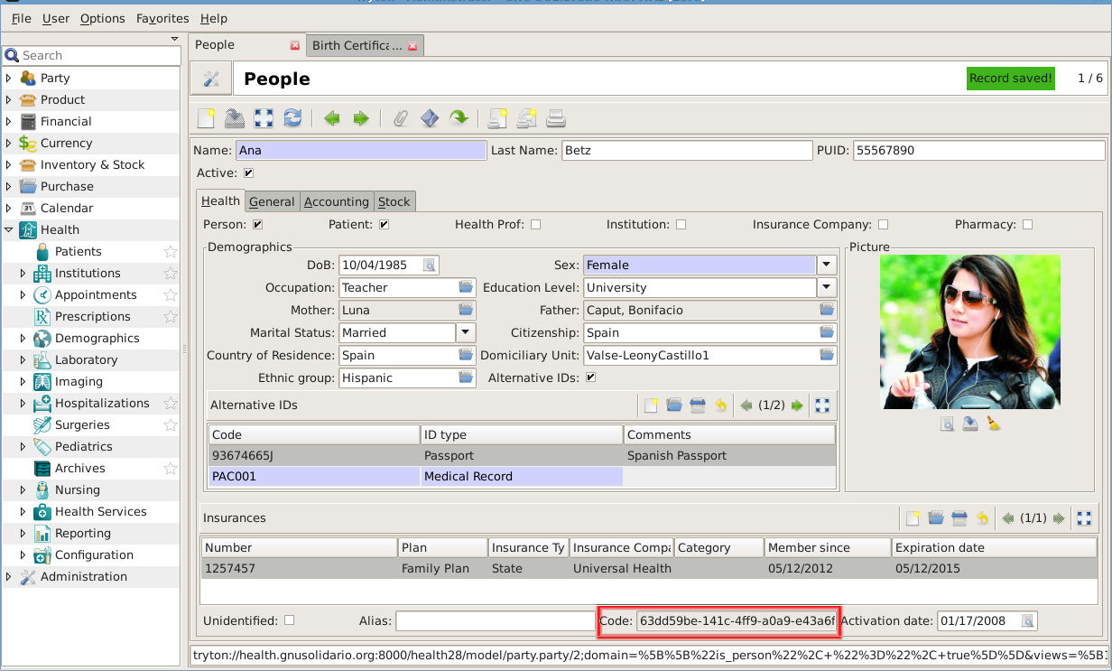
Oneperson,onehistory:PUID
63dd59be-141c-4ff9-a0a9-e43a6f754b39-GNU SOLIDARIO HOSPITAL
openSUSEConference,osCON18 CzechRepublic,May26th,2018
LuisFalcónMartín GnuSolidario.CC-BY-NC-SA4.0

Slide 31
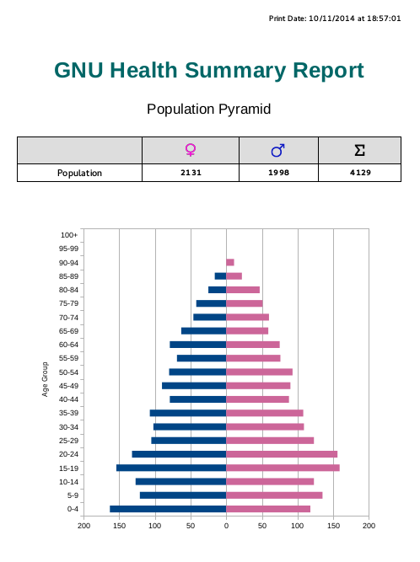
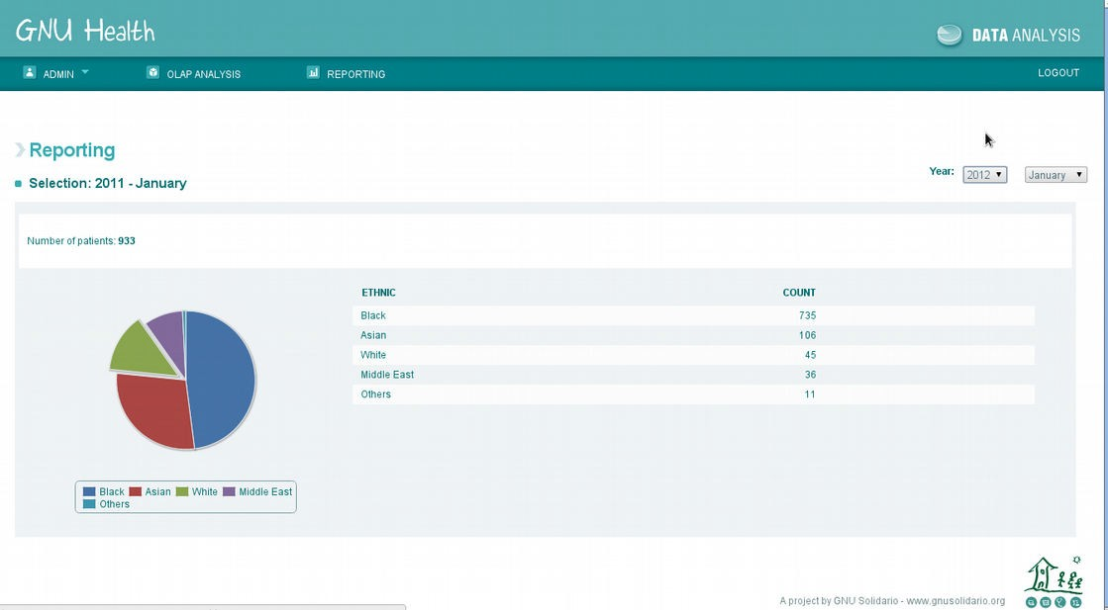
Demographics,Epidemiology,EarlyWarning
Data aggregation Demographics
People without health coverage
Vital Records Sytem Outbrake early warning Geolocalization (OSM) Notifiable diseases
openSUSEConference,osCON18 CzechRepublic,May26th,2018
LuisFalcónMartín GnuSolidario.CC-BY-NC-SA4.0

Slide 32
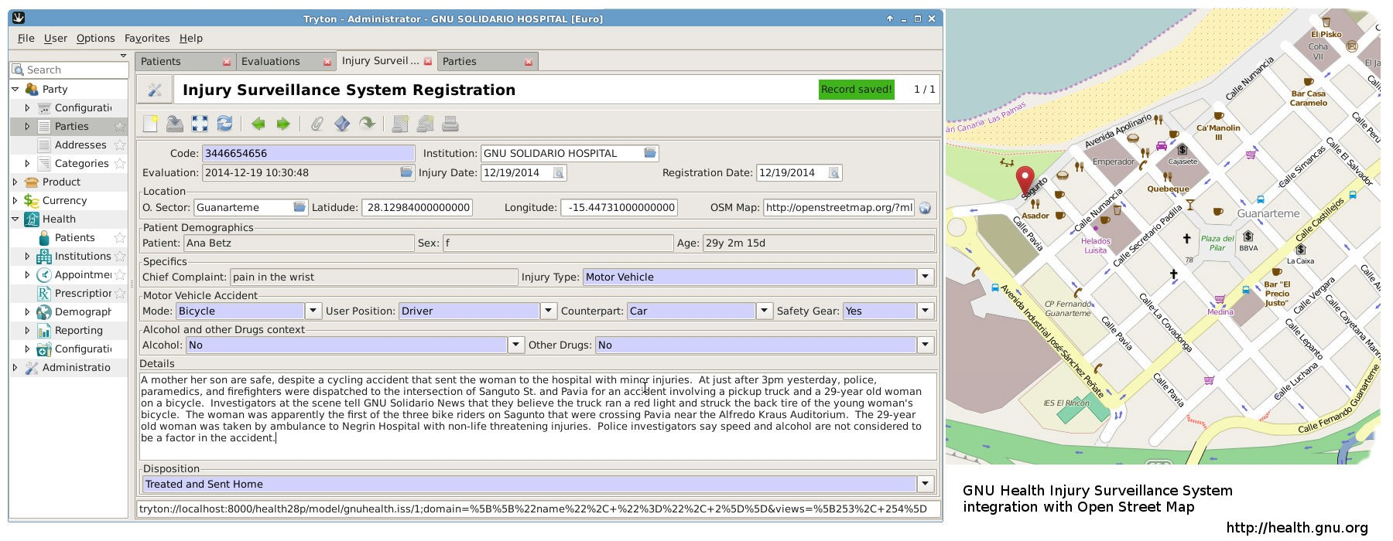
InjurySurveilanceSystem
Records violent injuries (accidents, robberies, self harm, sexual assaults,... ) Georeferenced
ICD 10 encoded
Contextual information (place, time, subjects involved, … ) Thanks to Jamaica MoH !
openSUSEConference,osCON18 CzechRepublic,May26th,2018
LuisFalcónMartín GnuSolidario.CC-BY-NC-SA4.0

Slide 33
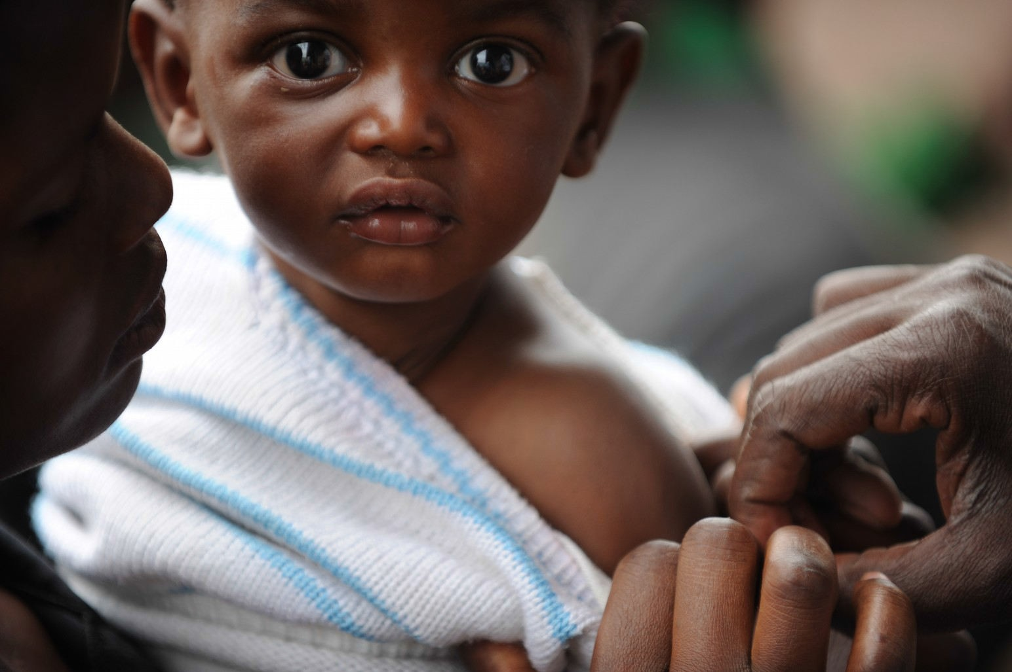

HealthCampaigns
Personalized campaigns (age, sex, social conditions, … )
Immunization status of the population Risk groups (obesity, diabetes, … )
openSUSEConference,osCON18 CzechRepublic,May26th,2018
LuisFalcónMartín GnuSolidario.CC-BY-NC-SA4.0

Slide 34

GNUHealthembed ed
openSUSEConference,osCON18 CzechRepublic,May26th,2018
LuisFalcónMartín GnuSolidario.CC-BY-NC-SA4.0

Slide 35
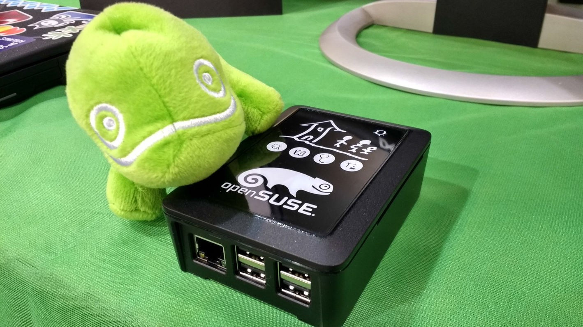
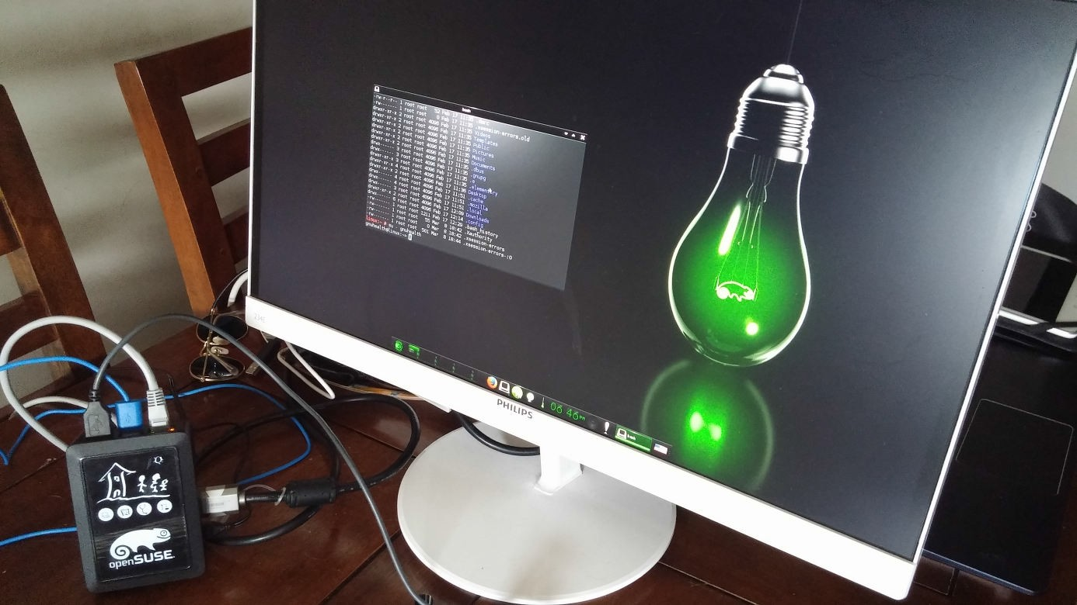
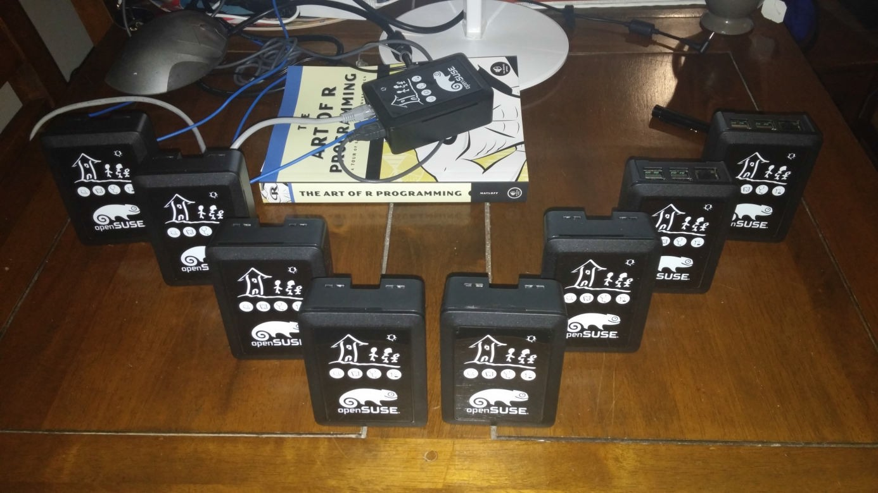

GNUHealth&RaspberyPi
Thanks OpenSUSE !
openSUSEConference,osCON18 CzechRepublic,May26th,2018
LuisFalcónMartín GnuSolidario.CC-BY-NC-SA4.0

Slide 36

MyGNUHealth(3.4)
openSUSEConference,osCON18 CzechRepublic,May26th,2018
LuisFalcónMartín GnuSolidario.CC-BY-NC-SA4.0

Slide 37


MyGNUHealth(3.4)
Demographics Appointments Telemedicine
BMI
Excercise Vitals
Blood Glucose levels
Nutrition Socioeconomics
Health History
openSUSEConference,osCON18 CzechRepublic,May26th,2018
LuisFalcónMartín GnuSolidario.CC-BY-NC-SA4.0

Slide 38
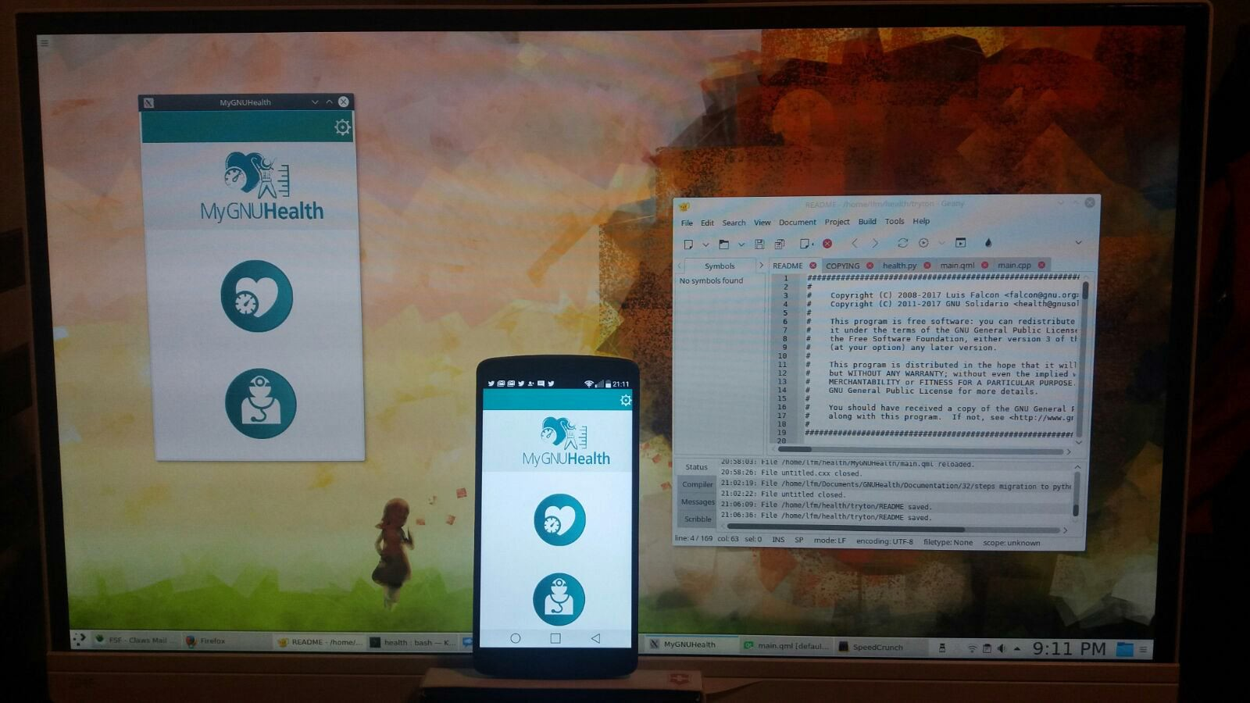
MobileandDesktopap lication
openSUSEConference,osCON18 CzechRepublic,May26th,2018
LuisFalcónMartín GnuSolidario.CC-BY-NC-SA4.0

Slide 39
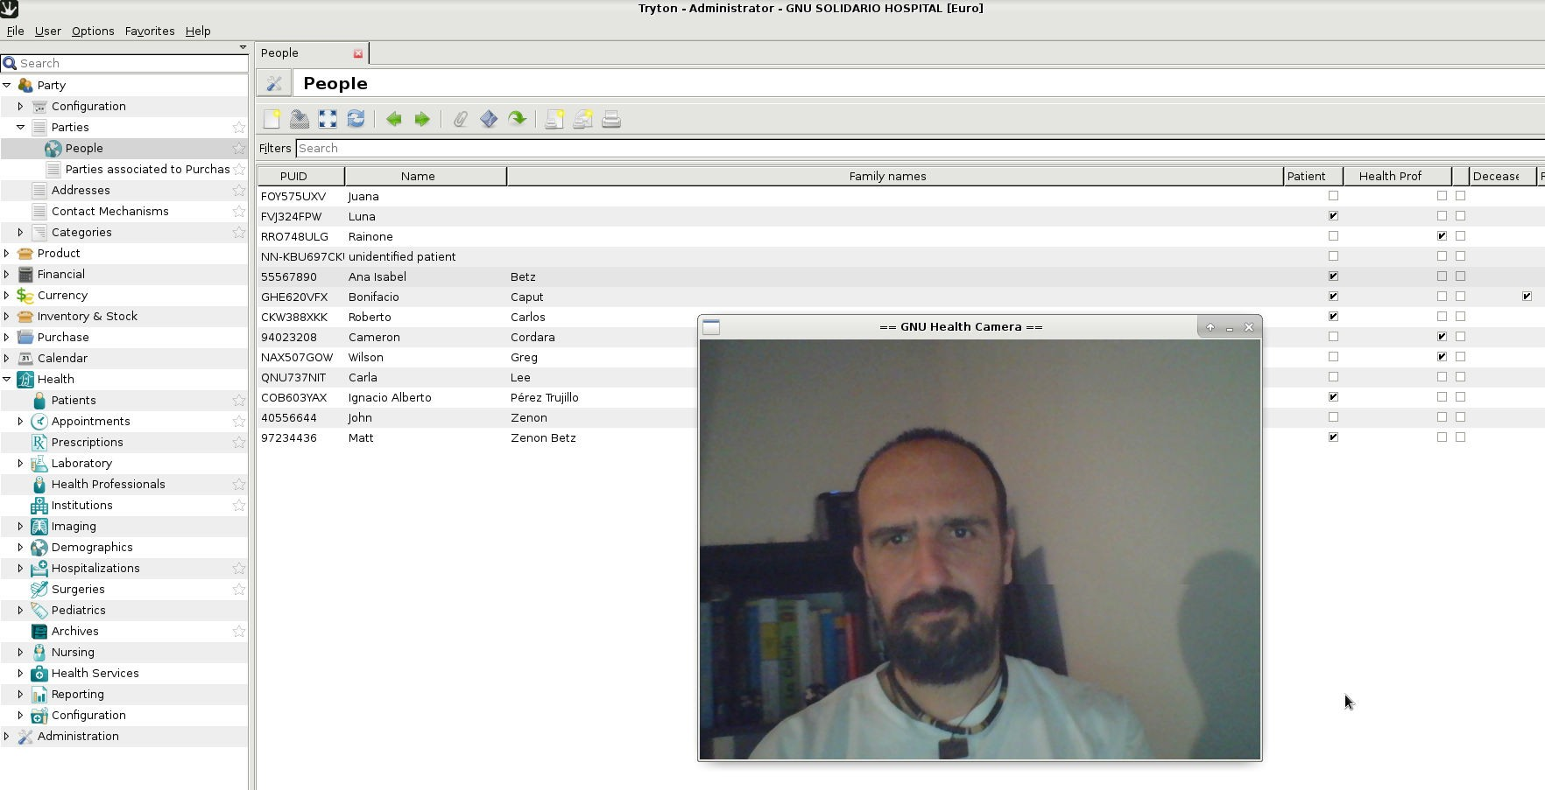
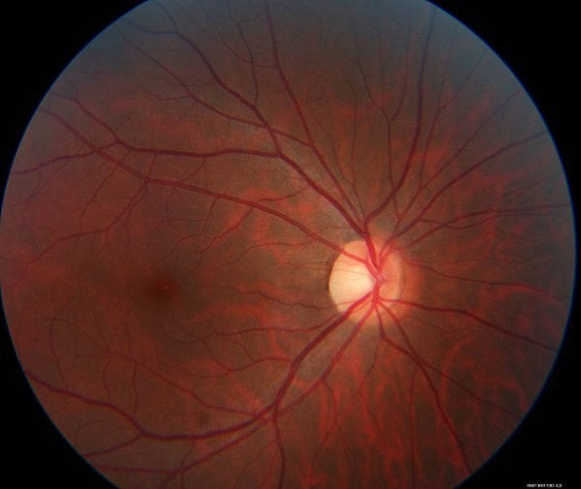
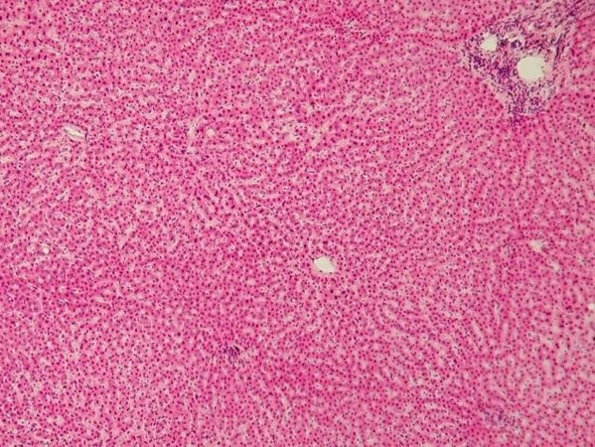
GNUHealthCamera
Person / Patient Registration DUs Surveys
Dx Imaging Histology / Pathology
...
openSUSEConference,osCON18 CzechRepublic,May26th,2018
LuisFalcónMartín GnuSolidario.CC-BY-NC-SA4.0

Slide 40

GNUHealthFederation
openSUSEConference,osCON18 CzechRepublic,May26th,2018
LuisFalcónMartín GnuSolidario.CC-BY-NC-SA4.0

Slide 41
















GNUHealthFederation
openSUSEConference,osCON18 CzechRepublic,May26th,2018
LuisFalcónMartín GnuSolidario.CC-BY-NC-SA4.0

Slide 42
GNUHealthFederation
Autonomous Distributed Heterogeneous Scalable
High availability Secure
openSUSEConference,osCON18 CzechRepublic,May26th,2018
LuisFalcónMartín GnuSolidario.CC-BY-NC-SA4.0

Slide 43
health.gnu.org
GNUHealth Planet
openSUSEConference,osCON18 CzechRepublic,May26th,2018
LuisFalcónMartín GnuSolidario.CC-BY-NC-SA4.0

Slide 44

Thankyou,geko!
Active GNU Health member
Ships GNU Health package
Sponsor (GNUHealthCon)
Donation of Raspberry Pis
Great, friendly community
openSUSEConference,osCON18 CzechRepublic,May26th,2018
LuisFalcónMartín GnuSolidario.CC-BY-NC-SA4.0

Slide 45

Fredom =Liberty=Community=Ownership=Control
openSUSEConference,osCON18 CzechRepublic,May26th,2018
LuisFalcónMartín GnuSolidario.CC-BY-NC-SA4.0

Slide 46
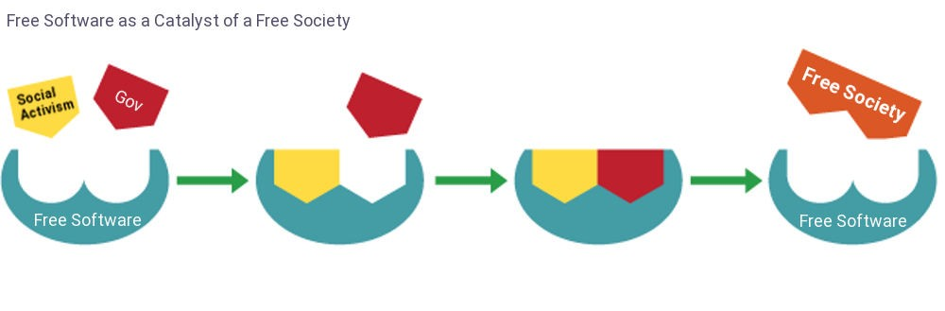
But….it’saboutco lectiveFredom !
Evolution and progress comes from collaboration, not from competition
openSUSEConference,osCON18 CzechRepublic,May26th,2018
LuisFalcónMartín GnuSolidario.CC-BY-NC-SA4.0

Slide 47
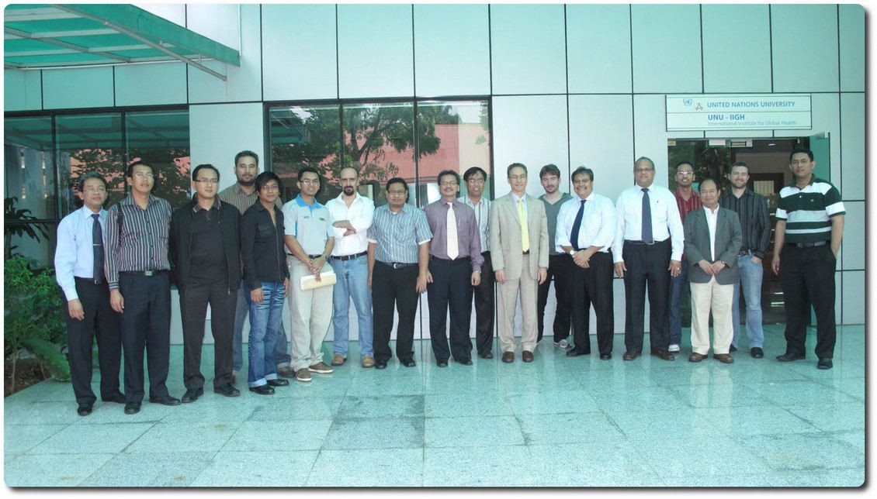
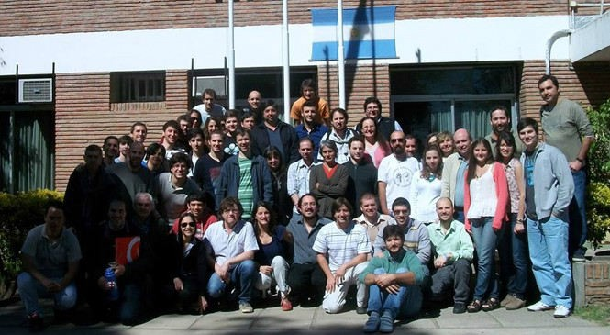
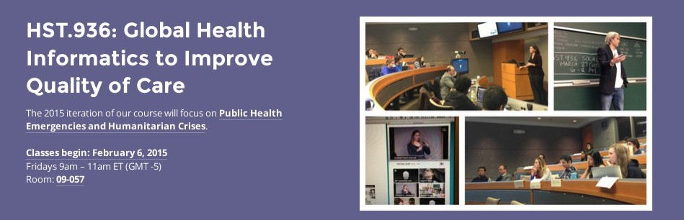



GNUHealthandtheAcademia
UnitedNationsUniversity,KualaLumpur,Malasia
UniversityofEntreRios,Argentina
Harvard/MIT,Boston,UnitedStates
Univ.Matanzas,Cuba
openSUSEConference,osCON18 CzechRepublic,May26th,2018
Univ.Palermo,Italy
LuisFalcónMartín GnuSolidario.CC-BY-NC-SA4.0

Slide 48




Universities…jointheGNUHealthAliance!
openSUSEConference,osCON18 CzechRepublic,May26th,2018
LuisFalcónMartín GnuSolidario.CC-BY-NC-SA4.0

Slide 49

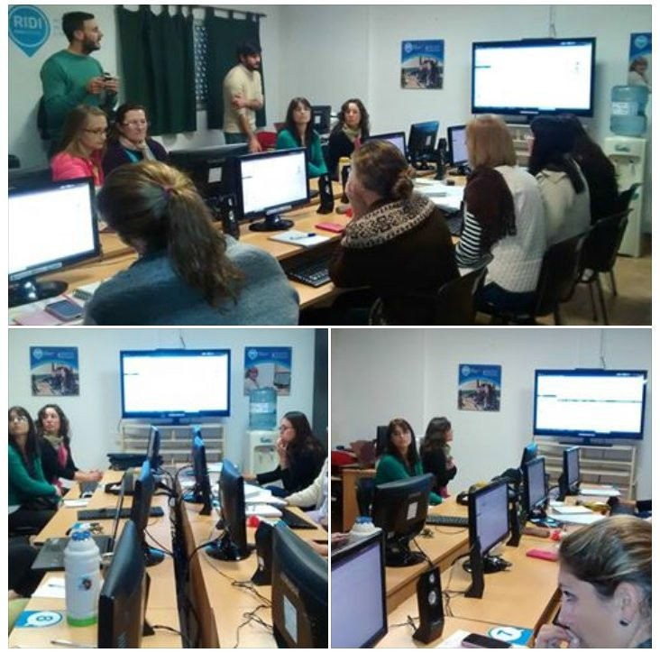

UniversidadNacionaldeEntreRios,Argentina
openSUSEConference,osCON18 CzechRepublic,May26th,2018
LuisFalcónMartín GnuSolidario.CC-BY-NC-SA4.0

Slide 50
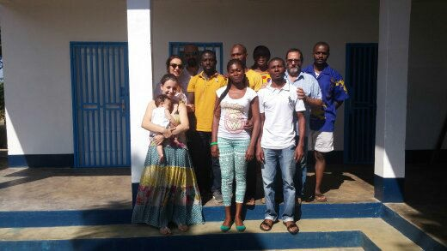

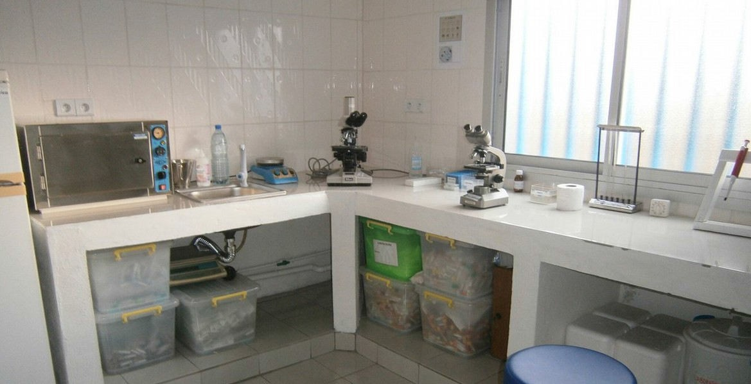

GNUHealthandInsolafrica
openSUSEConference,osCON18 CzechRepublic,May26th,2018
LuisFalcónMartín GnuSolidario.CC-BY-NC-SA4.0

Slide 51

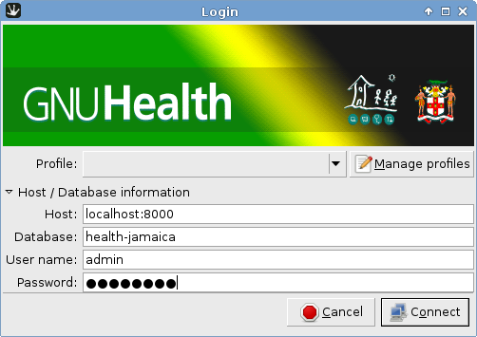
GNUHealthatheGovernmentofJamaica
Started as a joint project between Government of Jamaica Ministry of Health and GNU Solidario
Local team
Sustainability and independence
Unique ID for each individual across the country
GNU/Linux on both workstations and servers
openSUSEConference,osCON18 CzechRepublic,May26th,2018
LuisFalcónMartín GnuSolidario.CC-BY-NC-SA4.0

Slide 52

350+“GNU”Healthfacilitiesnation-wide
openSUSEConference,osCON18 CzechRepublic,May26th,2018
LuisFalcónMartín GnuSolidario.CC-BY-NC-SA4.0

Slide 53




GNUHealthinArgentina
openSUSEConference,osCON18 CzechRepublic,May26th,2018
LuisFalcónMartín GnuSolidario.CC-BY-NC-SA4.0

Slide 54




GNUHealthatLaosPublicHealthSystem
openSUSEConference,osCON18 CzechRepublic,May26th,2018
LuisFalcónMartín GnuSolidario.CC-BY-NC-SA4.0

Slide 55


GNUHealth&WorldHealthOrganization
MDG6 : Malaria, TB, HIV
Essential list of medicines Neglected Tropical Diseases
ICD-10
ICPM
MDG4 : Reduce Child mortality
Immunization schedules Pediatric growth charts
openSUSEConference,osCON18 CzechRepublic,May26th,2018
LuisFalcónMartín GnuSolidario.CC-BY-NC-SA4.0

Slide 56

GNUHealth&WorldHealthOrganization
ICD-10
Training sessions with WHO Africa regional officers
openSUSEConference,osCON18 CzechRepublic,May26th,2018
LuisFalcónMartín GnuSolidario.CC-BY-NC-SA4.0

Slide 57



Camero n-PublicDistrictHospital
openSUSEConference,osCON18 CzechRepublic,May26th,2018
LuisFalcónMartín GnuSolidario.CC-BY-NC-SA4.0

Slide 58




Mexico
openSUSEConference,osCON18 CzechRepublic,May26th,2018
LuisFalcónMartín GnuSolidario.CC-BY-NC-SA4.0

Slide 59

RedCros Mexico/CruzRoja
Over 300,000 visits / year
openSUSEConference,osCON18 CzechRepublic,May26th,2018
LuisFalcónMartín GnuSolidario.CC-BY-NC-SA4.0

Slide 60

Bikop-Camero n
openSUSEConference,osCON18 CzechRepublic,May26th,2018
LuisFalcónMartín GnuSolidario.CC-BY-NC-SA4.0

Slide 61

Pakistan,Islamabad
Dr. Akbar Niazi Teaching Hospital (ANTH), a 500-bed hospital in Islamabad
openSUSEConference,osCON18 CzechRepublic,May26th,2018
LuisFalcónMartín GnuSolidario.CC-BY-NC-SA4.0

Slide 62

Welcome,AIMS!
All India Institute of Medical Sciences, AIIMS
Largest publich health hospital in Asia
openSUSEConference,osCON18 CzechRepublic,May26th,2018
LuisFalcónMartín GnuSolidario.CC-BY-NC-SA4.0

Slide 63








Someco lareasofwork
openSUSEConference,osCON18 CzechRepublic,May26th,2018
LuisFalcónMartín GnuSolidario.CC-BY-NC-SA4.0

Slide 64

GetheGNUGenerationinvolved!
openSUSEConference,osCON18 CzechRepublic,May26th,2018
LuisFalcónMartín GnuSolidario.CC-BY-NC-SA4.0

Slide 65



Reachout!
openSUSEConference,osCON18 CzechRepublic,May26th,2018
LuisFalcónMartín GnuSolidario.CC-BY-NC-SA4.0

Slide 66

IWEEE&GNUHealthCon2018
Celebrating10yearsofFredom andEquityinHealthcare
November 23 -25, Las Palmas, Spain http://www.gnuhealthcon.org
openSUSEConference,osCON18 CzechRepublic,May26th,2018
LuisFalcónMartín GnuSolidario.CC-BY-NC-SA4.0

Slide 67


MedicineisaSocialScience
“Medicine science,
is a social and politics is
nothing else but medicine on a large scale”
Rudolf Virchow
http://health.gnu.org
@gnuhealth
openSUSEConference,osCON18 CzechRepublic,May26th,2018
LuisFalcónMartín GnuSolidario.CC-BY-NC-SA4.0

Slide 68


Healthisanon-negotiablehumanright
http://health.gnu.org
@gnuhealth
openSUSEConference,osCON18 CzechRepublic,May26th,2018
LuisFalcónMartín GnuSolidario.CC-BY-NC-SA4.0

